Slide 1
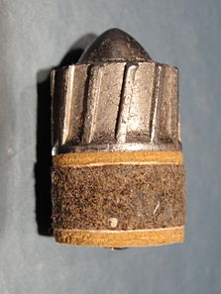
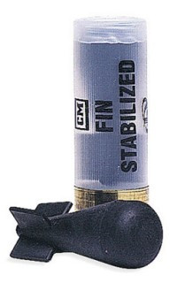
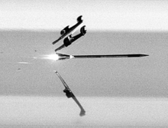
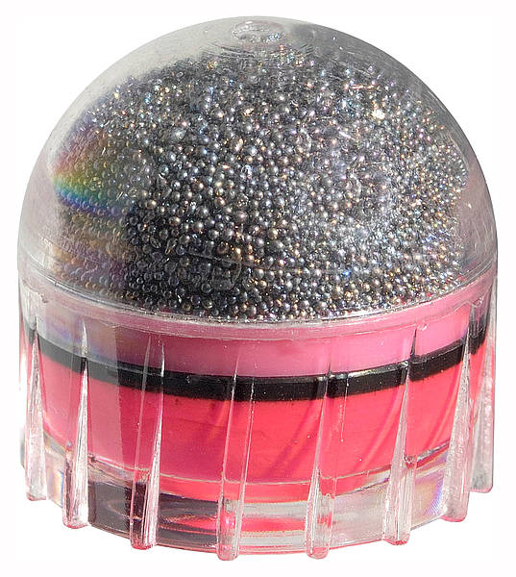
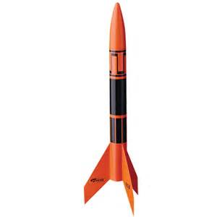
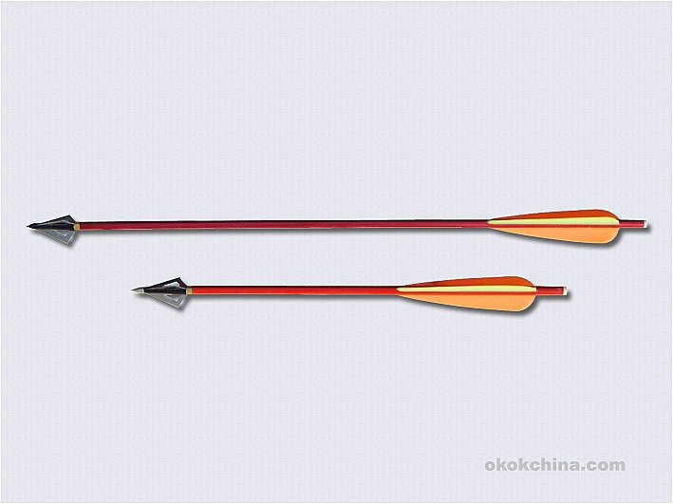
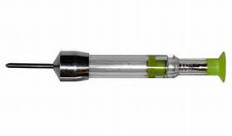
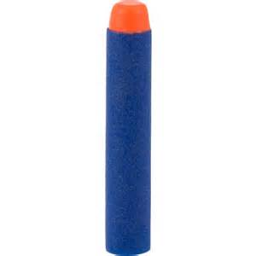
Drag Stabilized Ballistics Modeling Group # 27
Joshua Stringam

Slide 2
WHY?
Ballistics has a wide range of applications
Military
Less than Lethal Weapons development
Delivering packages, Medicine in areas without infrastructure
Recreational (Hunting, target shooting)
Space Travel
Sky Diving (Some people like to be projectiles?)

Slide 3
Hypothesis
Could a ballistics model for Drag stabilized projectiles may have a good fit for spin stabilized projectiles under certain circumstances?
Yes, for short times of flight bullet orientation with respect to direction does not significantly change, allowing for meaningful fits.

Slide 4
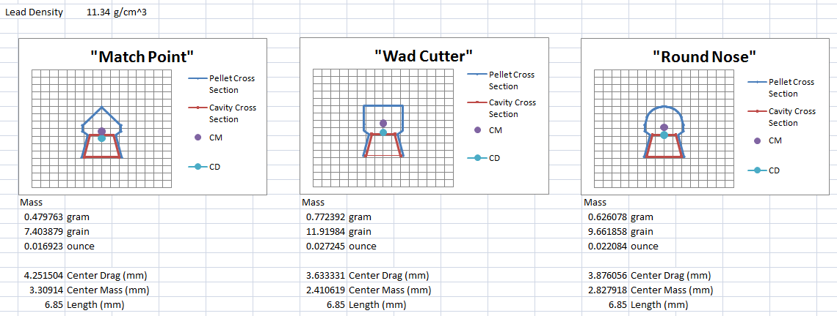
What Does Drag Stabilization Mean?
The projectile is designed such that drag forces keep the projectile pointed in the
direction of movement.

Slide 5
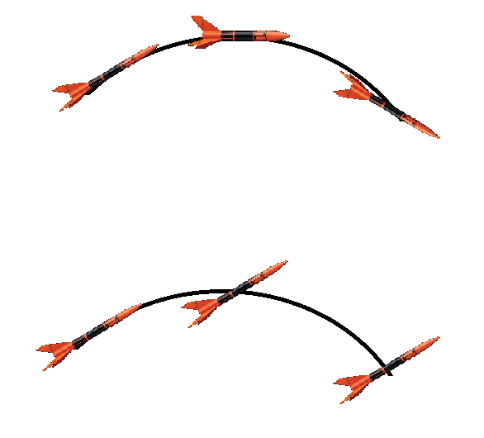
Drag Stabilized
Spin Stabilized

Slide 6


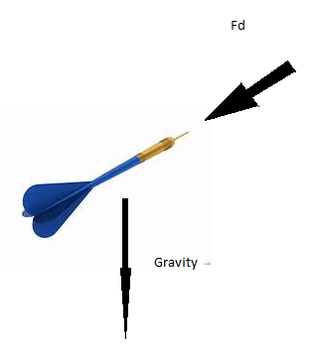
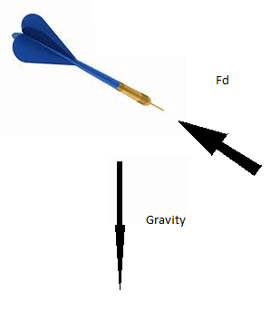
Governing Equations
Drag Equation
Ideal Gas Law (density)
Newton’s second law of motion
Turns Forces into accelerations

Slide 7
Euler’s Method with a little Trigonometry
dV/dt=A=Fd/m=-V(n)^2*Cd*ρ*Area
Ax(n)= Cos(ϴn)*A(n)
Ay(n)= (Sin(ϴn)*A(n))-gravity
Vx(n+1)=Vx(n)+dt(Ax)
Vy(n+1)=Vy(n)+dt(Ay)
V(n+1)=(Vx(n+1)^2 + Vy(n+1)^2)^0.5
ϴ(n+1)= atan(Vy(n+1)/Vx(n+1))
x(n+1)=((2/3)*x(n)+dt(Vx(n))) +((1/3)*(x(n) +(dt/2)(Vx(n)+Vx(n+1))
y(n+1)=((2/3)*y(n)+dt(Vy(n))) +((1/3)*(y(n) +(dt/2)(Vy(n)+Vy(n+1))
Drag Equation to find Deceleration normal to projectile movement
Use trigonometry to reassign direction of
Fd given Vx and Vy of current step.
Use Euler’s forward method to solve for Vx and Vy given Acceleration data.
Simpson’s Rule to solve for
X and Y given Vx and Vy data.

Slide 8
Iterations
Calculates Sum of error squared from experimental data,
Uses Newton’s method with finite differences in order to calculate modification to CD
Either modifies drag coefficient or angle in order to reduce error for 50*5 iterations
Magnitude of angle adjustment decreases with each 4th iteration, always tries to line
up with first point.
FP=(SESQ3-SESQ1)/(2*DCD);
FPP=(SESQ3-2*SESQ2+SESQ1)/(DCD^2);
Cmod=FP/FPP;
Cd=Cd-DCD-Cmod;

Slide 9
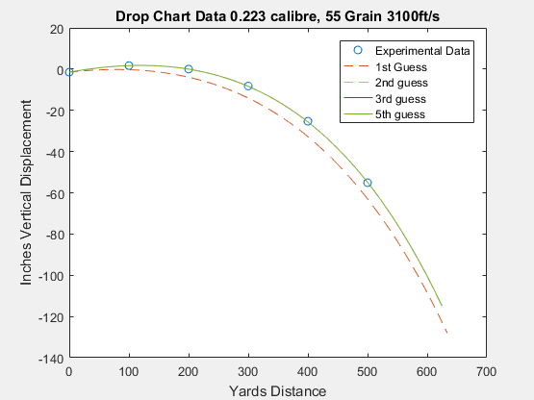
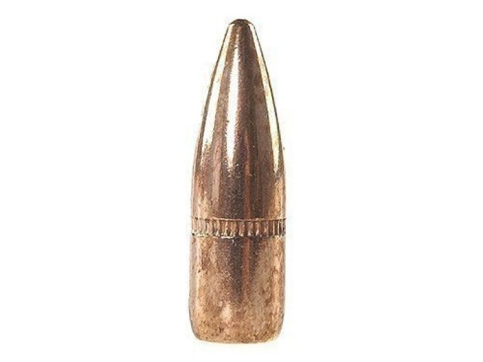
Cd 0.3905

Slide 10
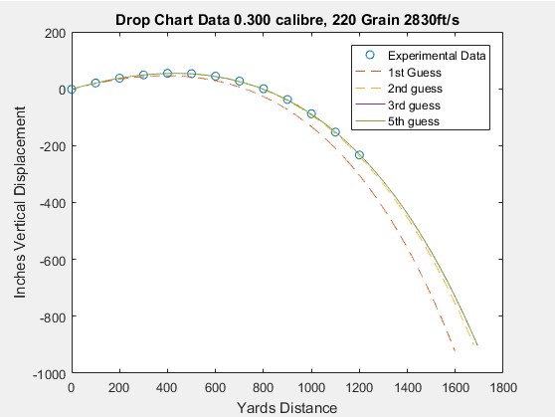
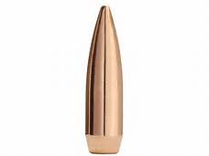
Cd 0.3239

Slide 11
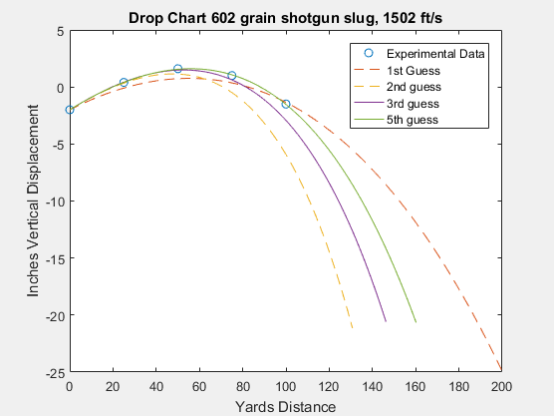

Cd 1.3897

Slide 12
What is Next?
Modify the model for uphill / downhill
Fit a curve under known temp/humidity conditions, test under other conditions
Add functionality for head and crosswind, thrust and burn data (rockets)
Atmospheric Pressure as a function of elevation
6 Parameter External ballistics modeling
Spin/crosswind interactions for rise and fall contributions
Better ODE solving methods for accuracy, larger scale (gravity as a function of coordinate, air density as a function of elevation, what can go into space?)

